Slide 1

Sinkd

Slide 2

Meet the Team
David “Tony” Bright
Crystele Dierickx
Sam Doroudi
Andrew Zhang
Chris Banci
Brandon Tilley

Slide 3
Sinkd
“The Cloud Storage Solution for the Ever Moving Student on the Go”
Notes:
The Problem to be solved : CSUSM student don’t have a centralized location to store and manage files unless they are apart of the CS department.
Sinkd gives all students from any major the ability to use a centralized location to store files.
Environment: CSUSM

Slide 4
What is Sinkd?
Sinkd is reliable and easy to use cloud storage. It lets students store, organize, and share files instantly.

Slide 5
Our process is easy
sign-up
sign-in
Anchor in!

Slide 6
Anchor in from anywhere!

Slide 7
Comparing
Dropbox
Sinkd
Box

Slide 8








DropBox
Sinkd
Box
Operating System
Mobile Compatible
Cost

Slide 9
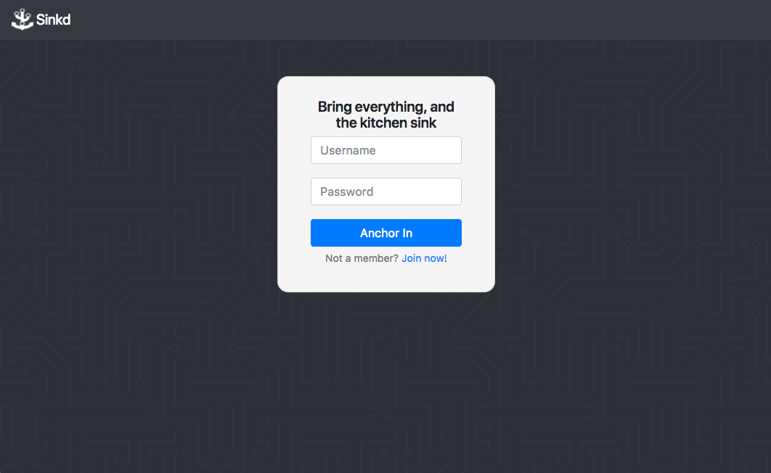
Desktop View
Sign-in Page

Slide 10
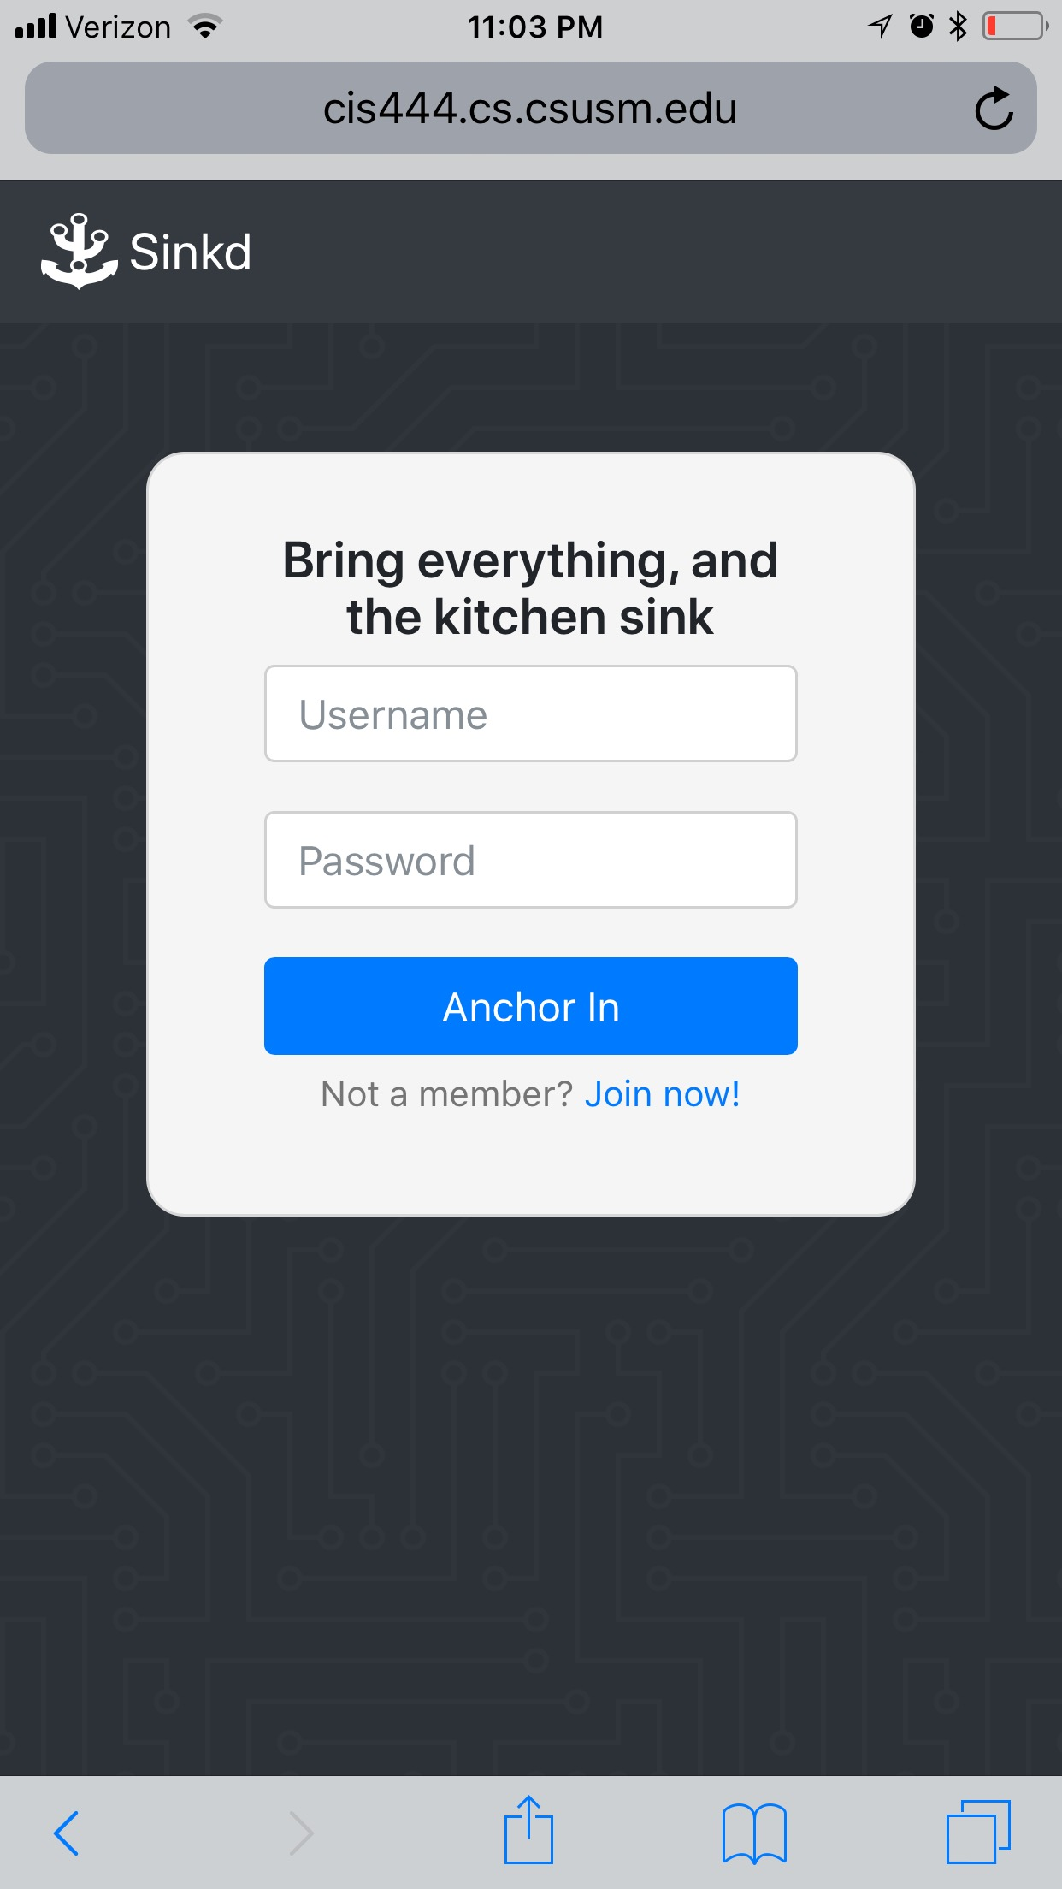
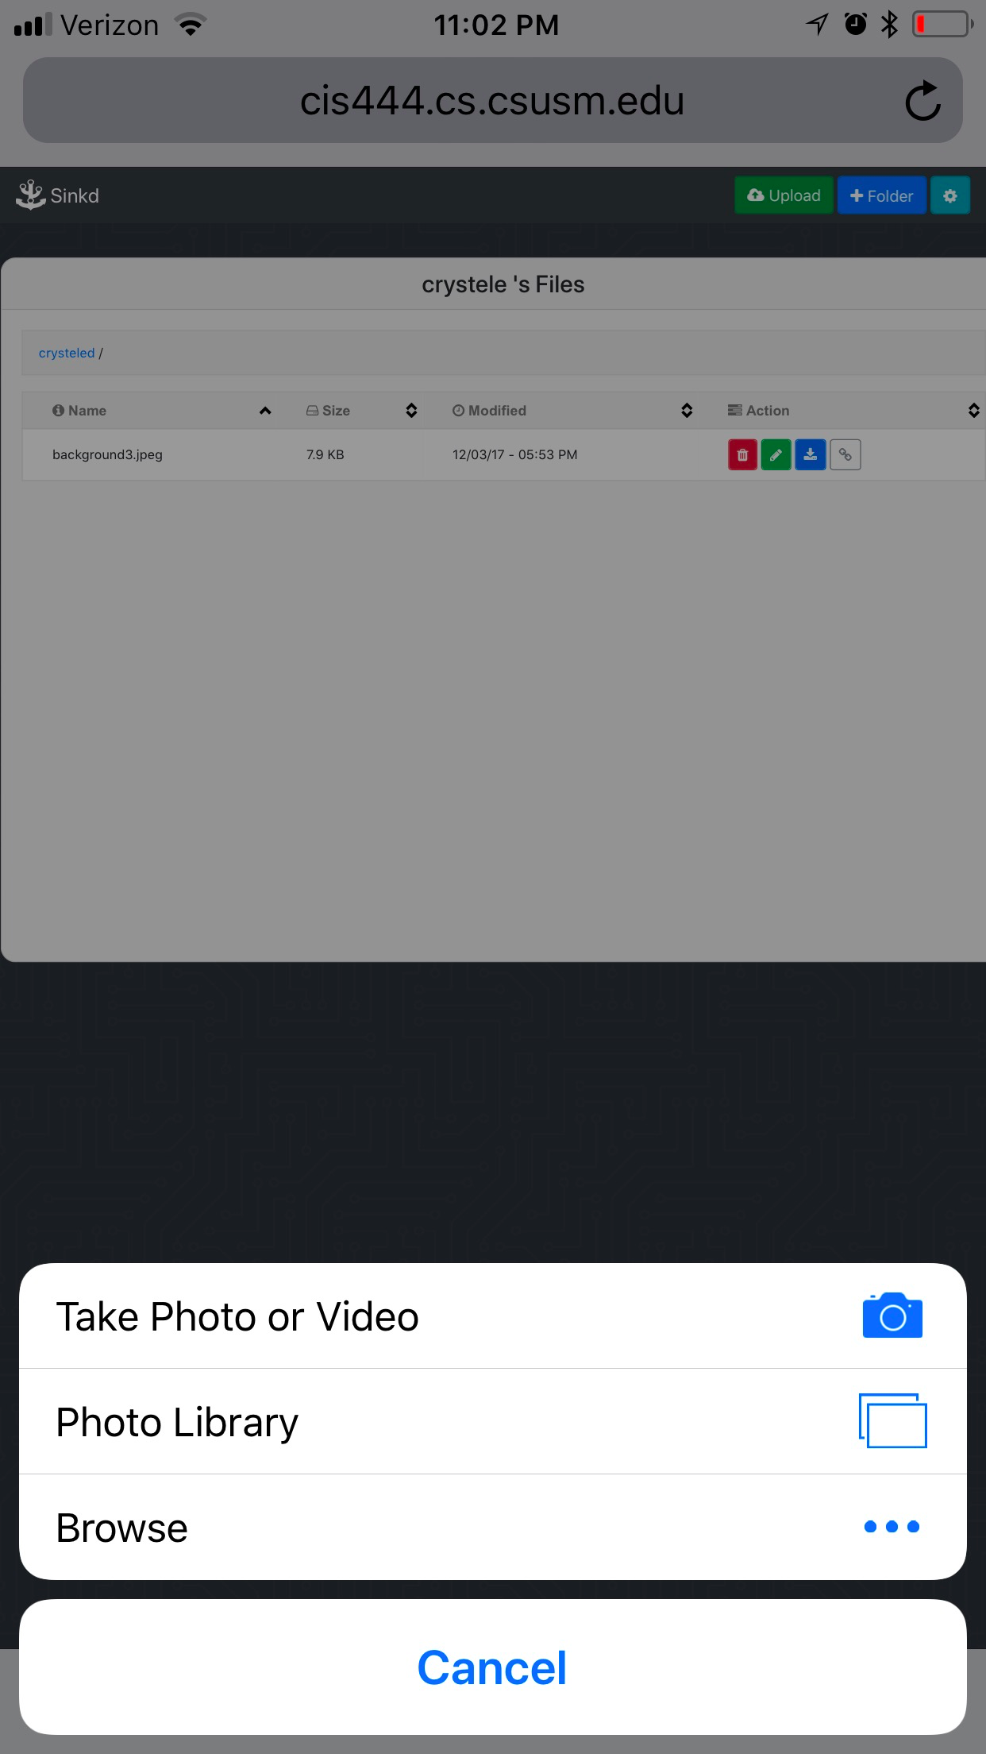
Mobile View

Slide 11
Behind the Scene
Notes:
Web transactions need to be demonstrated and explained

Slide 12
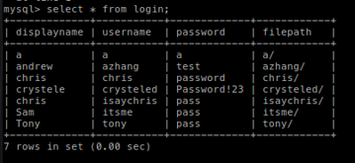
Database Design
SQL Table
Only need one table to store and verify account information

Slide 13
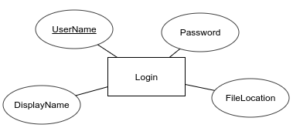
Database Design
Entity Relationship Diagram

Slide 14
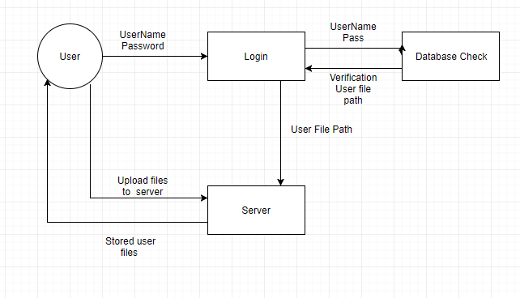
Database Design
Information Flowchart
Website Navigation flowchart

Slide 15
Demo
http://cis444.cs.csusm.edu/group_A/sinkd/login.php
Notes:
Web transactions need to be demonstrated and explained

Slide 16
Possible Enhancements

Slide 17
Possible Enhancements
Search bar:
Search for a specific file or folder
Account verification:
Verify account upon registering via email
Favorites:
Quick access to files or folders
Security:
Implement stronger security (hashing passwords)

Slide 18
Contributions

Slide 19
Individual Contributions
Andrew Zhang: Front-end, Back-end, Design
Brandon Tilley: Documentation, Web Organization, Maintenance, Testing
Chris Banci: Front-end, Back-end, Design
Crystele Dierickx: Documentation, Presentation, Design, Testing
David Bright: Management, Front-end, Back-end, Debugging
Sam Doroudi: Documentation, Presentation, Front-end, Testing

Slide 20
Thanks!
Q & A

